Slide 1
INTERNSHIP
Matthias Maes

Slide 2
ANOMALY DETECTION ENGINE

Slide 3
Weapons of choice
Python 2.7
MongoDB (RobotMongo)
Apache, Nginx (CentOS)

Slide 4
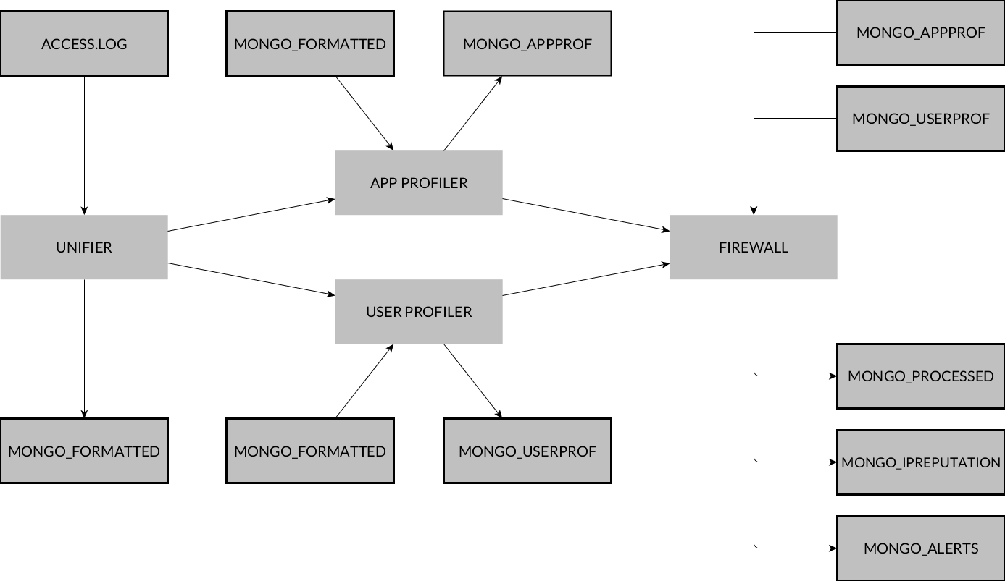
General overview

Slide 5
Metrics
Total connections
Location
Day
Time
Request URL
Filetype requested source

Slide 6
Metrics
HTTP Method
HTTP Status
User Agent
Timespent
Login
Param

Slide 7
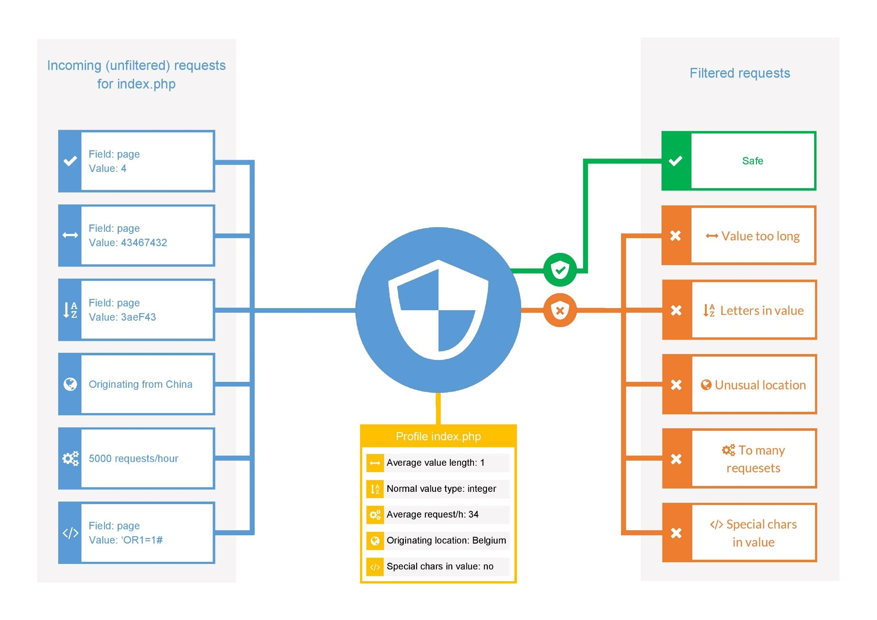

Slide 8
DEMO
Unifier

Slide 9
::1 - - [19/Apr/2017:15:14:39 +0200] "GET /test/index.html?token=54be68nk90po" 200 202575 "http://localhost:8080/test/about.html" "Mozilla/5.0 (Windows NT 6.1; Win64; x64) AppleWebKit/537.36 (KHTML, like Gecko) Chrome/57.0.2987.133 Safari/537.36"

Slide 10
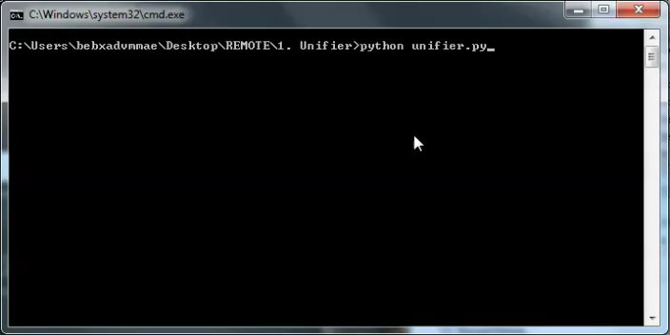

Slide 11
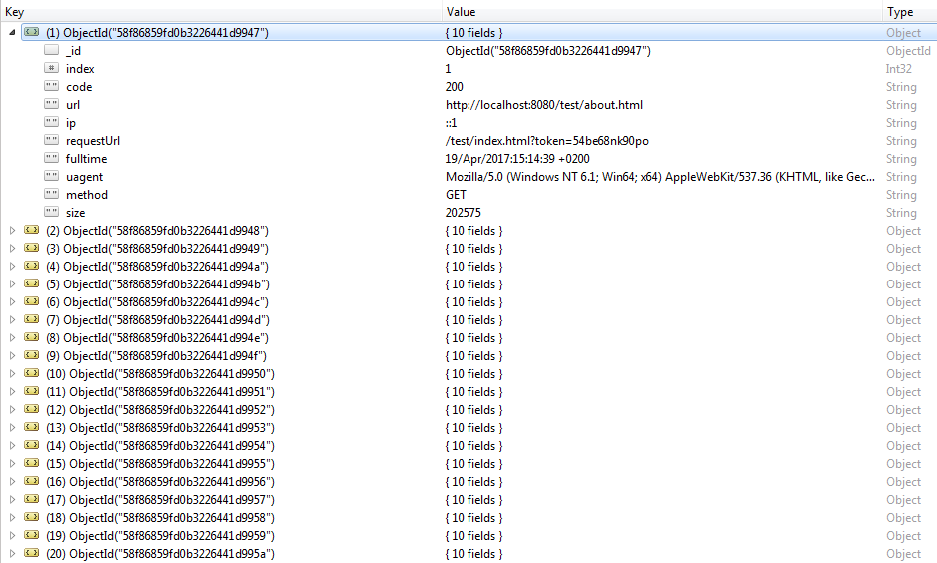
Result unifier

Slide 12
DEMO
Profiler

Slide 13
Result unifier

Slide 14
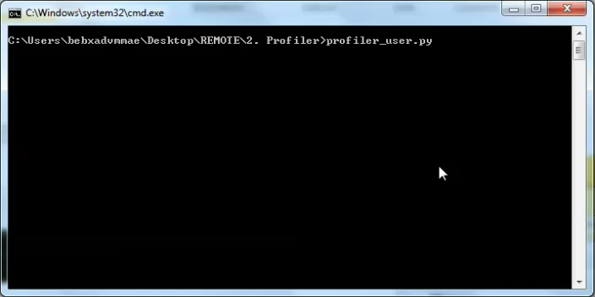

Slide 15
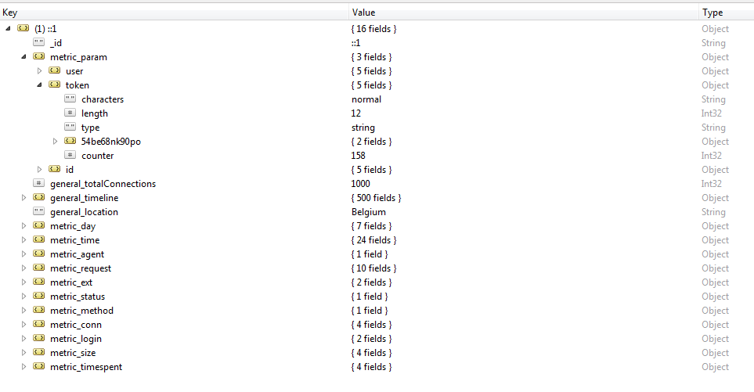
Result user profiling

Slide 16
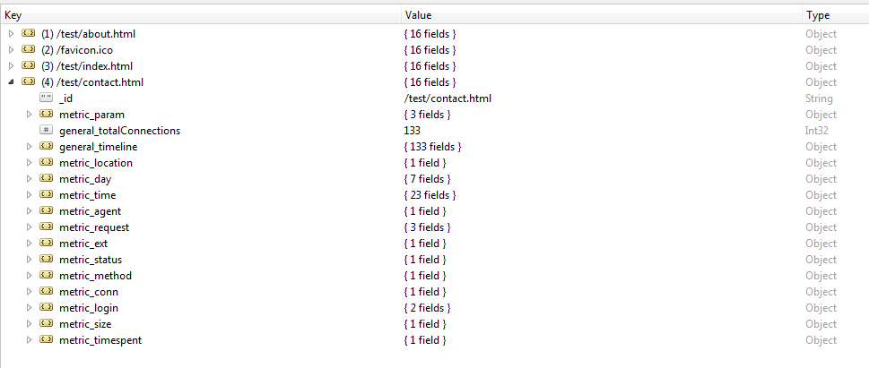
Result app profiling

Slide 17
DEMO
Firewall

Slide 18
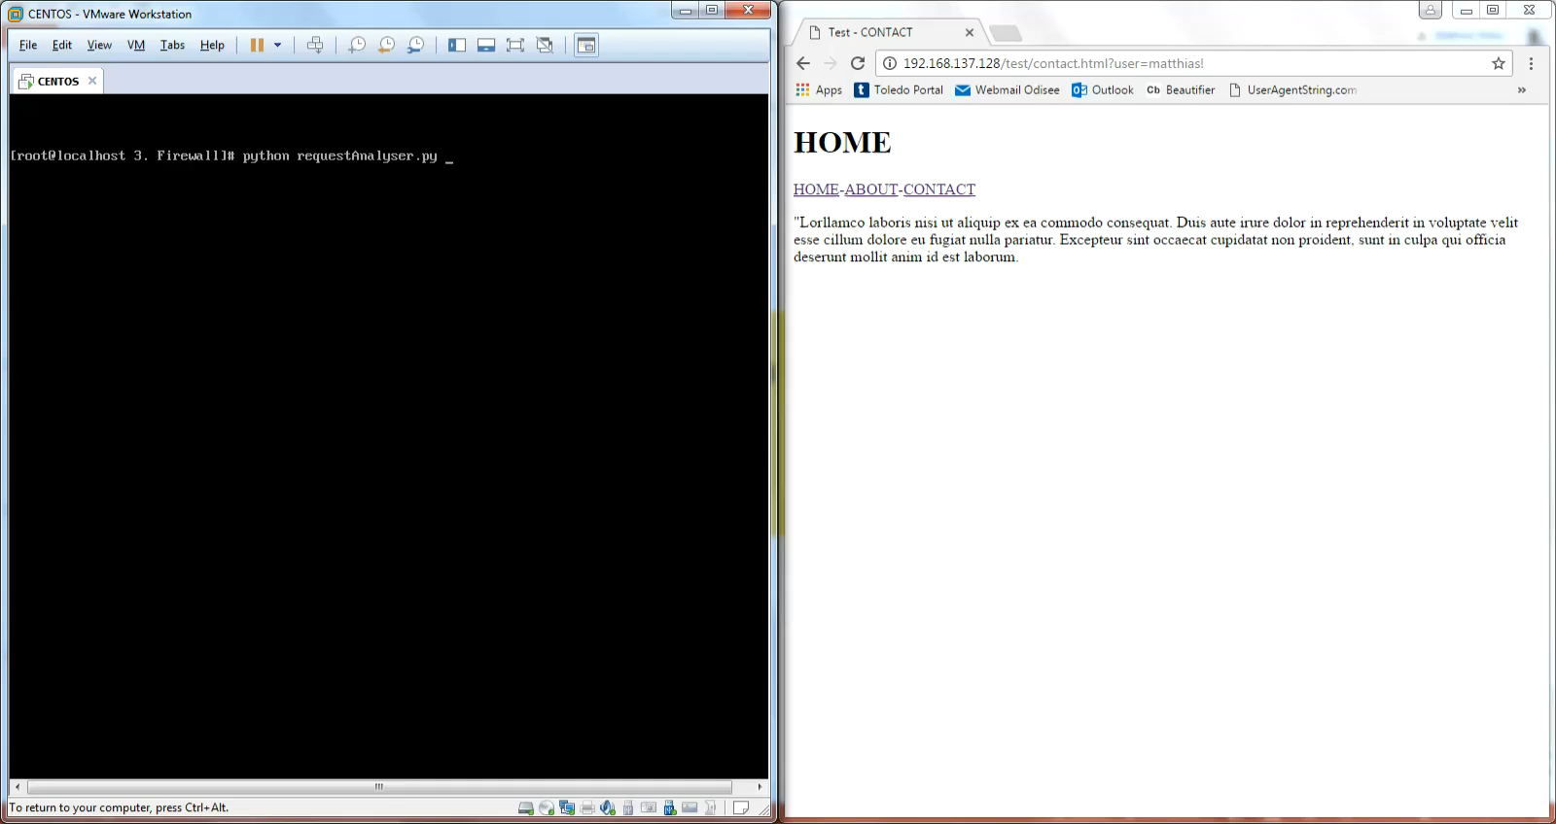

Slide 19
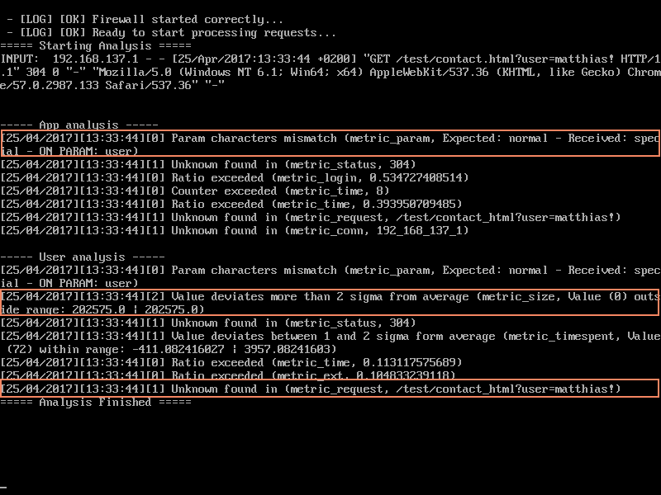
Test request: contact.html?user=matthias!

Slide 20
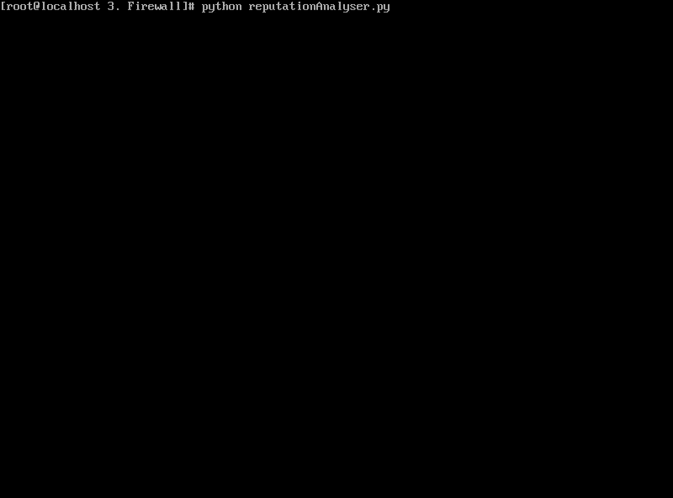
Reputation

Slide 21
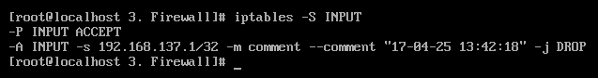
Reputation

Slide 22
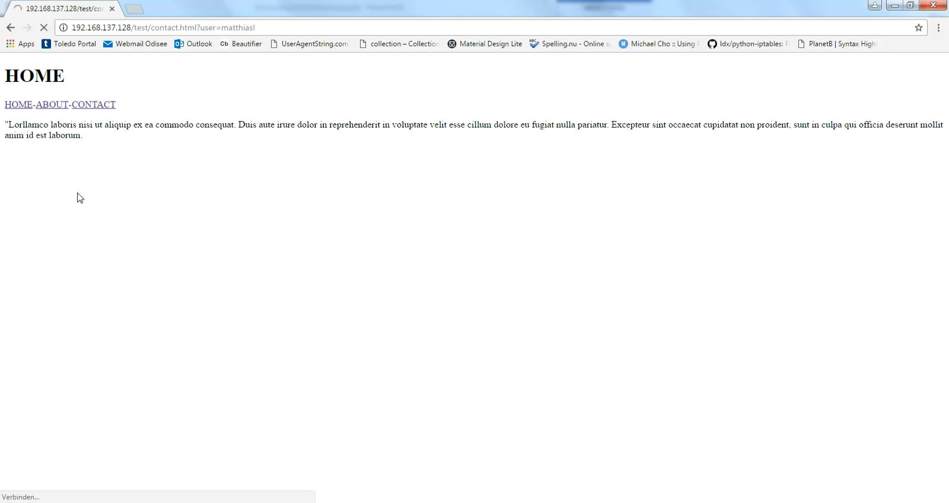
Reputation

Slide 23

Reset

Slide 24
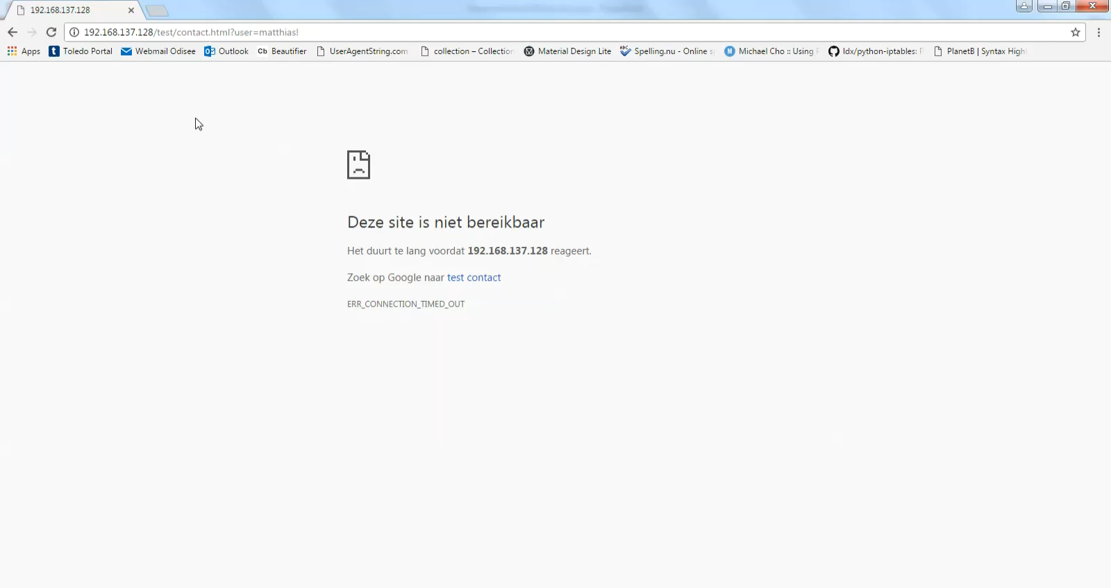
Reset

